Slide 1
ADOBE FRAMEWORK & AWS COST

Slide 2
DATA ISSUES & RCA
Problem statement & Impact | Data Source | Steps followed | Observations | Dependencies | Remedial Steps Initiated
• The historical data for the Visits and Orders columns is missing for January 3rd, 5th, 26th, 28th 2025, in the ds_flow_by_quality_type table of the Digital Pulse Dashboard. | ds_flow_by_quality_type | • Temporary tables were created in the sandbox account using the Glue job input Parquet files • Understanding of Glue job's functionalities, including its modules, source files, and target files. | • Source S3 path updates daily, containing only the latest 7 days of data. • New partition folders ware added to the output S3 path for ds_flow_visits_quality & ds_flow_order_quality, but not for ds_flow_by_quality_type. • Based on the PySpark script and CloudWatch logs, a Full Load is used for ds_flow_by_quality_type, and Incremental Load is used for ds_flow_visits_quality and ds_flow_order_quality. | • The parquet files in source s3 path are generated by CloudOps team | • Raised a ticket HLP000011662979 to run the job to get the Historical Data from CloudOps team
• The data for affordability tiers is missing from January 7th onwards in the chsi_tier_migration_desc column of the ds_revenue_summary table for the MDU Quick Connect, Affiliate, and Affordability Dashboards. | ds_revenue_summary | • Temporary tables were created in the sandbox account using the Glue job input CSV files • Understanding of 3 Glue job's functionalities, including its modules, source files, and target files. | • Found that, the data is missing in the source input CSV files itself | • The CSV files in source s3 path are generated by CloudOps team | • Raised a HLP ticket for further support to CloudOps team

Slide 3
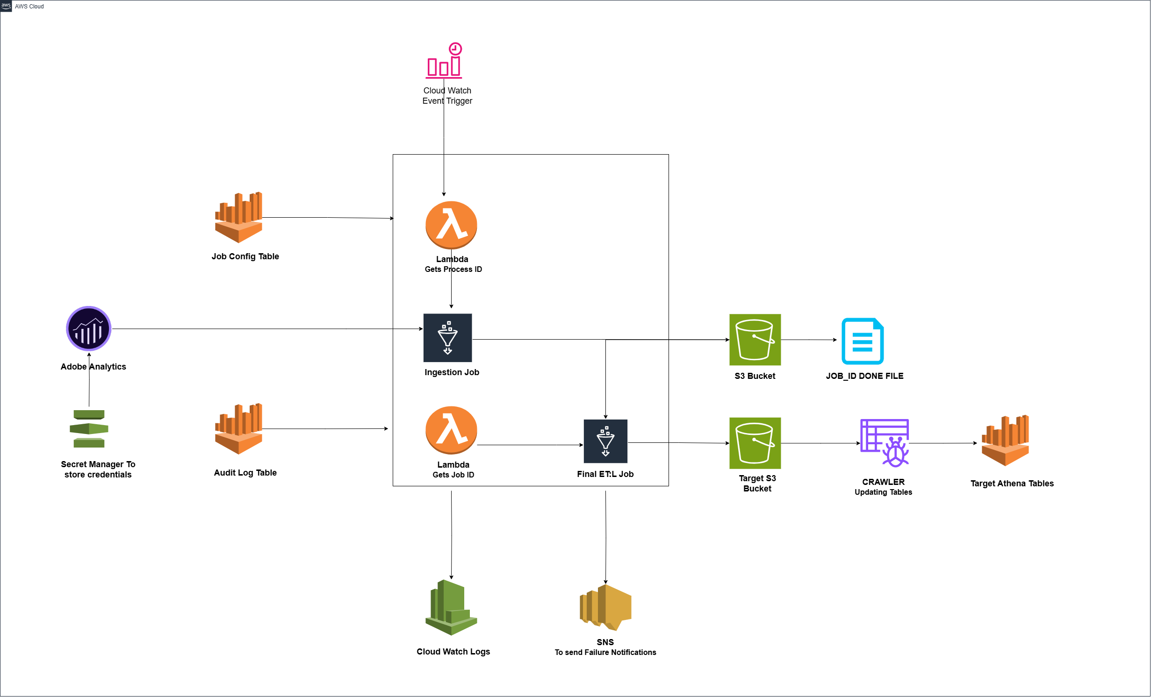
EXISTING ADOBE FRAMEWORK
CloudWatch triggers Lambda Function, which fetches Process IDs from the Config table to start the Glue job.
Glue job calls the Adobe API, loads the JOBID_DATE.Done file into S3, and updates job status in audit/config tables.
Lambda Function retrieves Job_ID from Config table and triggers the next Glue job for further transformations.
Glue job fetches data from S3 and performs necessary transformations & write it into target s3 paths
API credentials are stored in Secrets Manager, with SNS notifications for failed jobs and CloudWatch logs for Glue and Lambda.

Slide 4
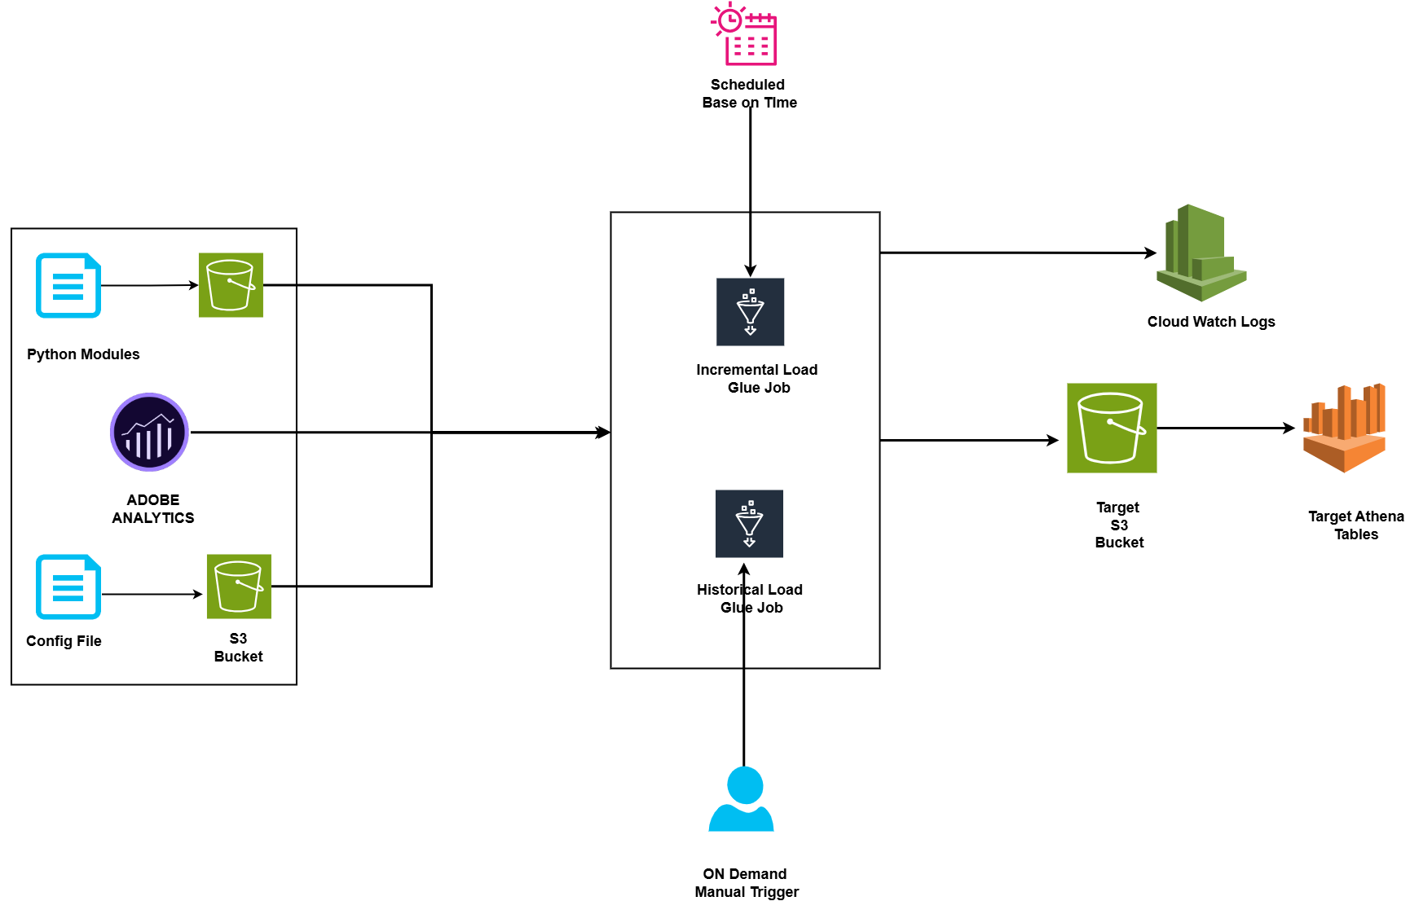
NEW ADOBE FRAMEWORK
Historical jobs are triggered on-demand, while incremental jobs are scheduled time
Both jobs reference configuration files containing parameter lists for Adobe API calls.
Python module establishes connection to Adobe API, retrieves data, and writes it to S3.
Adobe data is retrieved, transformed via Glue jobs, and written to designated S3 paths.
CloudWatch monitors and logs activity for Glue jobs.

Slide 5
OBSERVATIONS IN BOTH FRAMEWORK
Aspect | Existing Adobe Framework | New Adobe Framework
Process ID & Job Status | Uses Config and Audit tables to manage Process IDs and job status entries. | Only Config file is used
Job Scheduling | Operates based on scheduled times in CloudWatch. | Historical load runs on an on-demand trigger, while Incremental load runs on a scheduled basis.
Job Architecture | Utilizes 2 Lambda functions and 2 Glue jobs for reading Adobe API data, transforming it, and processing it. | Similar job architecture with Historical Load and Incremental Load, but no Lambda Functions is used
Table Creation | Crawlers are used to create tables. | Athena tables are created directly through hive queries within the job, eliminating the need for crawlers.
Failure Notification | SNS is used to send failure notifications to the respective team. | SNS is not used
API Credentials Management | Secret Manager is used for securely storing API endpoints and credentials. | Directly added the API endpoints & Credentials in Config file
Load Types | No specific differentiation between historical and incremental loads. | Two distinct load types: Historical Load (on-demand) and Incremental Load (scheduled), with configurable dates.

Slide 6
AWS COST SUMMARY – EDS ACCOUNT
Date | Month | Billing Summary | Cost Explorer (All) | Cost Explorer (Glue)
19-03-2025 | OCT-24 | $49,429.06 | $64,910.00 | $28.392.01
19-03-202 | NOV-24 | $67,528,80 | $88,690.91 | $47,816.57
19-03-2025 | DEC-24 | $72227.29 | $94,615.47 | $53,600.23
19-03-2025 | JAN-25 | $76,413.39 | $100,023.72 | $49,994.37
19-03-2025 | FEB-25 | $62,028.49 | $81,277.63 | $41,527.14
19-03-2025 | MAR-25 | $36.241.96 | $79,817.05 | $32,662.40
20-03-2025 12PM | MAR-25 | $37,603.07 | $49,387.23 | $20706.98
20-03-2025 9PM | MAR-25 | $38,292.58 | $49,387.23 | $38,292.5
21-03-2025 12PM | MAR-25 | $37,603.07 | $49,387.23 | $21,013.10
21-03-2025 9PM | MAR-25 | $39,885.16 | $51,882.35 | $21,557.38
24-03-2025 12PM | MAR-25 | $43,552.05 | $57,226.43 | $23,352.56
24-03-2025 9PM | MAR-25 | $43,552.05 | $57,226.43 | : $23,352.56
25-03-2025 12PM | MAR-25 | $44566.26 | $58553.26 | $23,794.36

Slide 7
Thank you message
© 2024 eClerx. All rights reserved. This presentation and its contents are protected by copyright laws and international treaties. Unauthorized use, reproduction, duplication, or distribution of this material, in whole or in part, is strictly prohibited. No portion of this presentation may be copied, transmitted, or otherwise used, in any form or by any means—whether electronic, mechanical, or otherwise—without the express prior written consent of eClerx. Any unauthorized use or distribution of this material may result in legal action.

